Slide 1

#Code-Chef – MAHINDRA FIRST CHOICE CASE STUDY
OMKAR MANGALGIRI
Kuldeep Choudhary
MuRshid kHAN
BriJENDRa TIWARI

Slide 2
Problem Statement
Geo location Based Analysis
Generate meaningful insights on Geolocation based customer & revenue analysis
Market Segmentation
Divide the customer base into segments based on their car type, service type & total spend such that these customers will respond similarly to the different marketing campaigns.
Customer Lifetime Value Prediction
Life time value analysis of customers to maintain relationship with high profit generating customers in future & finding potential customers from the population.

Slide 3
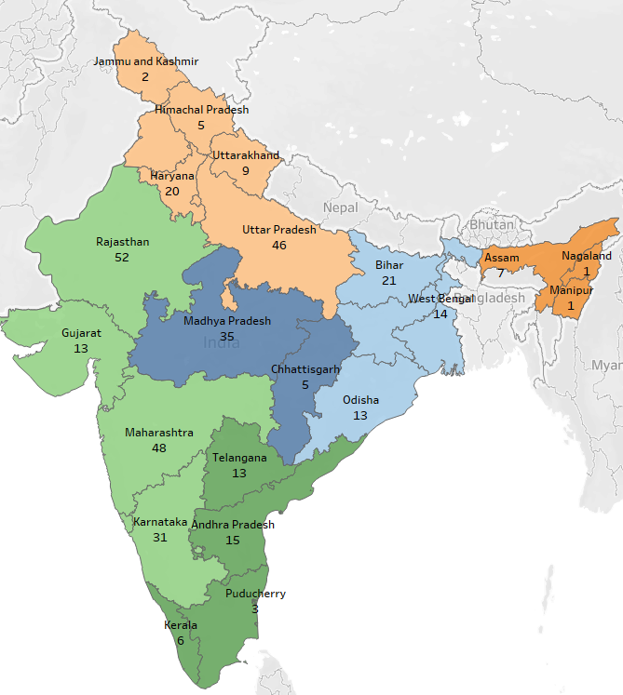
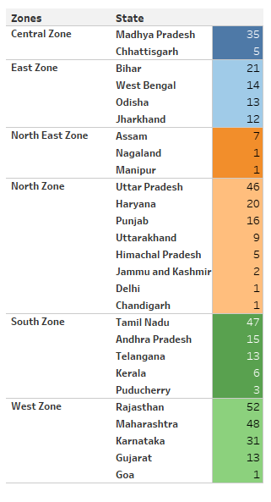
Geo location Based PLANT Analysis

Slide 4
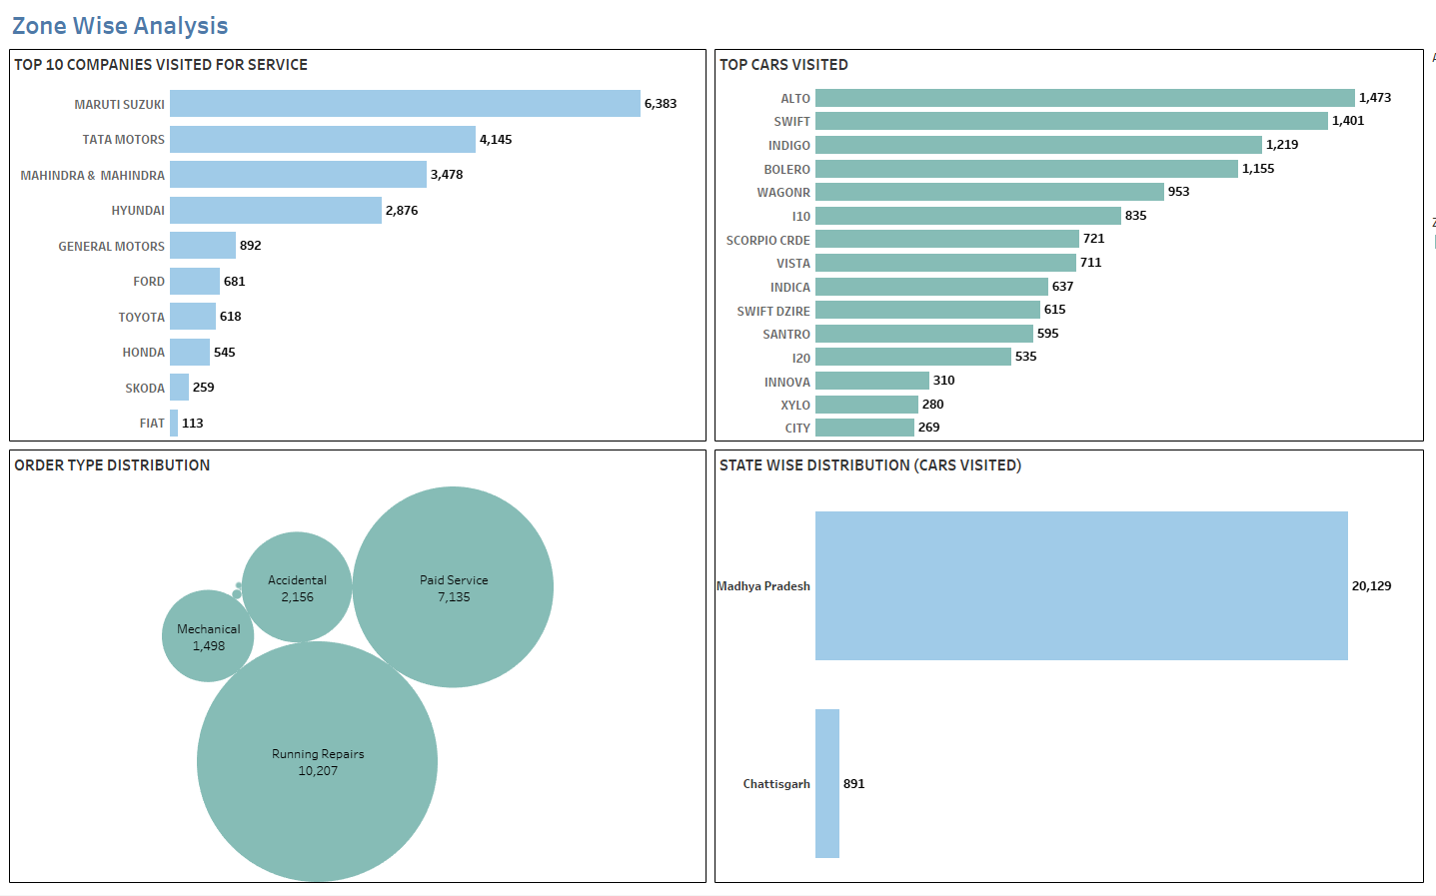
ZONE WISE ANALYSIS - central

Slide 5
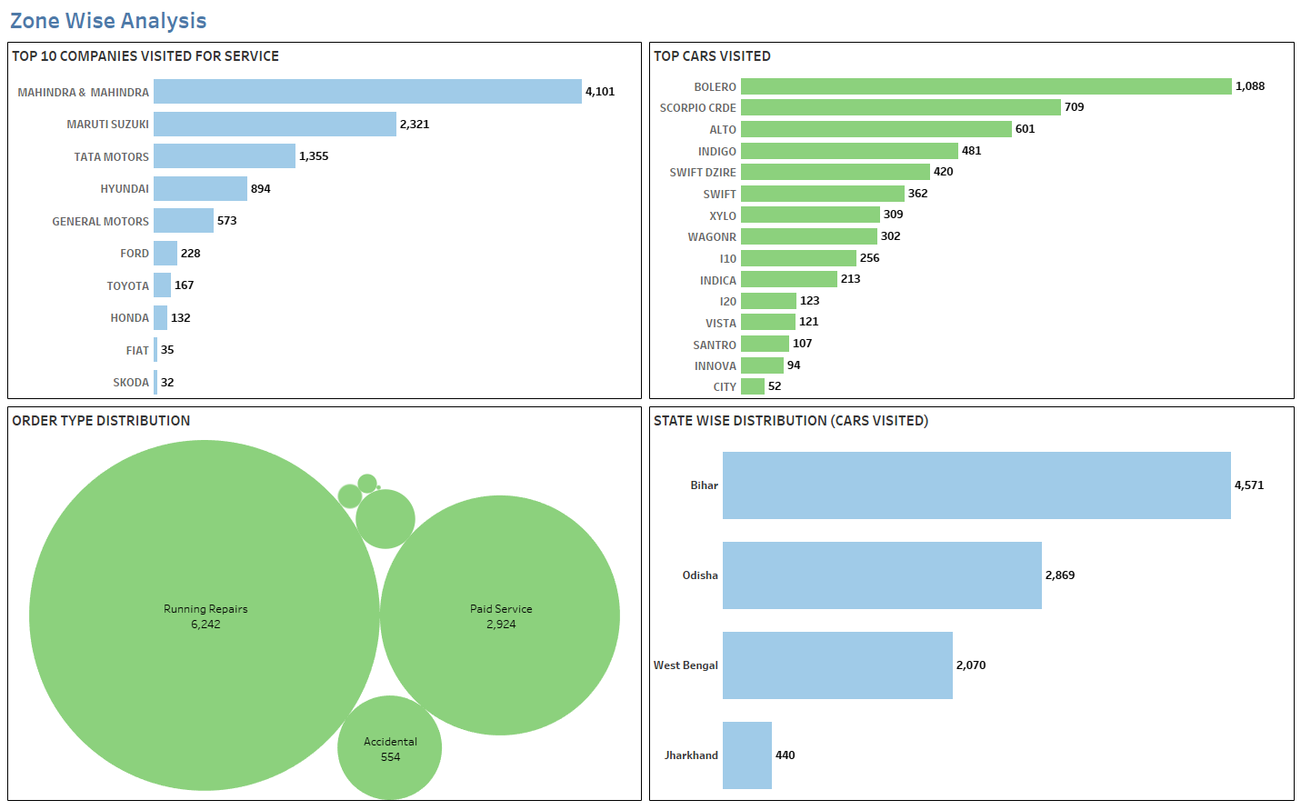
ZONE WISE ANALYSIS – east ZONE

Slide 6
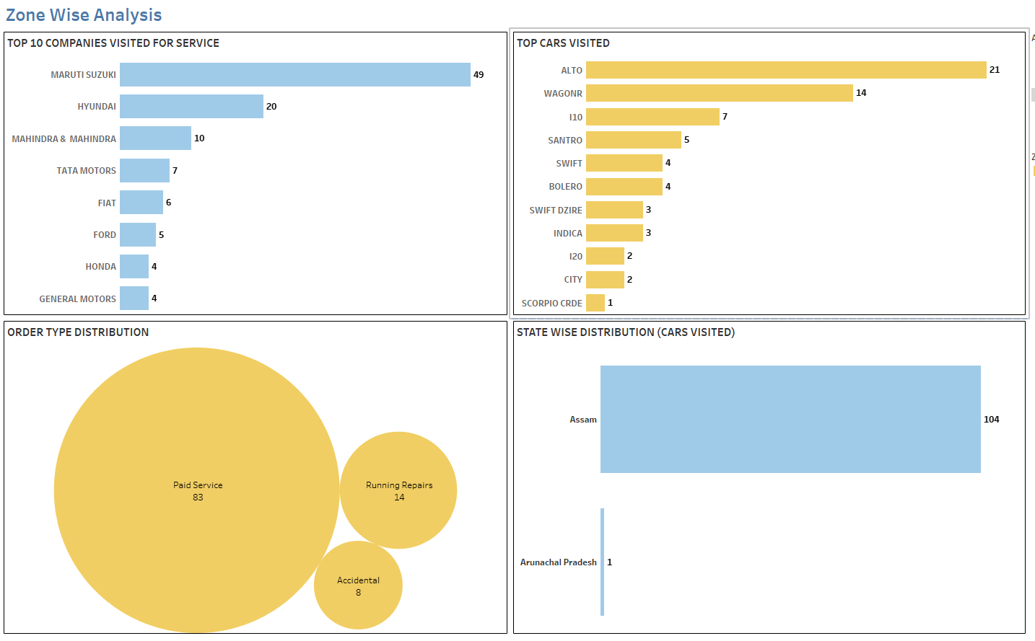
ZONE WISE ANALYSIS – north-east ZONE

Slide 7
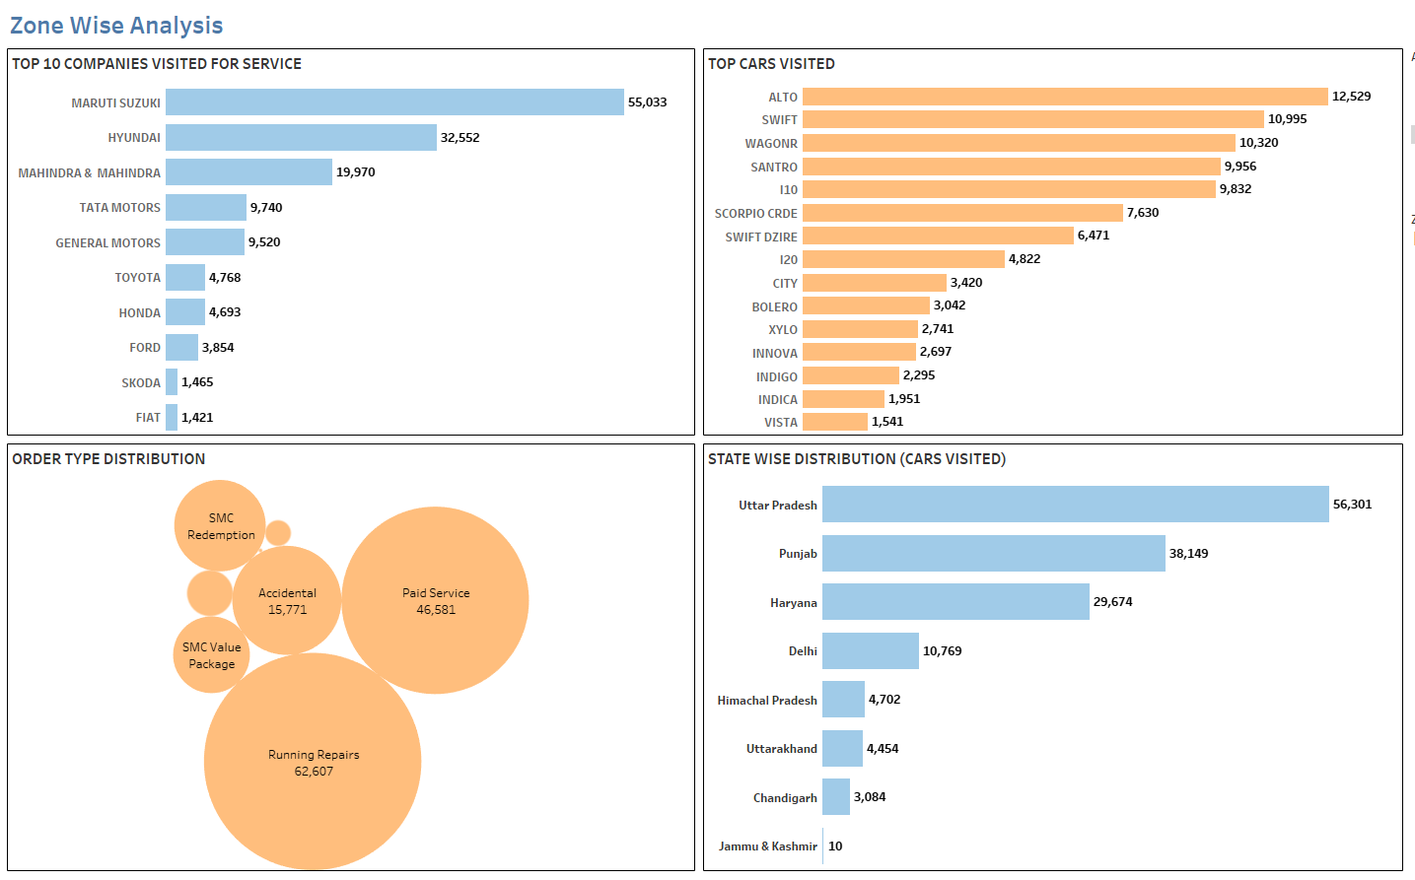
ZONE WISE ANALYSIS – north ZONE

Slide 8
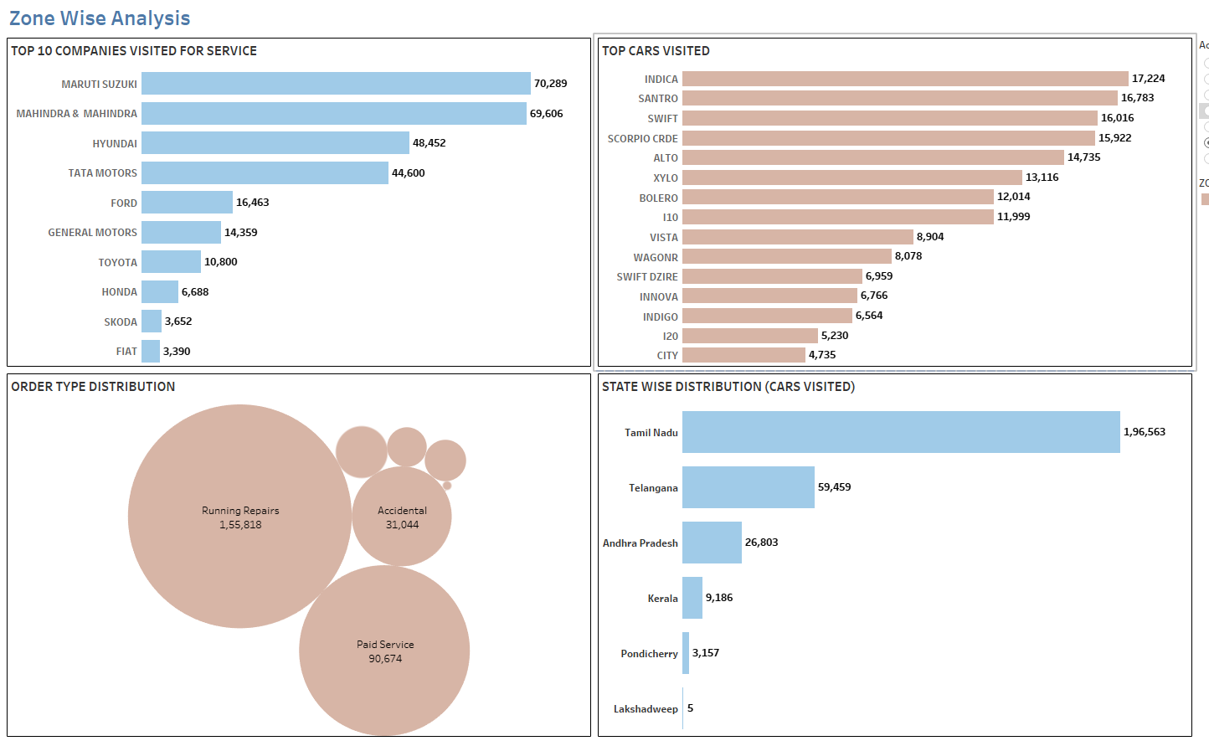
ZONE WISE ANALYSIS – SOUTH ZONE

Slide 9
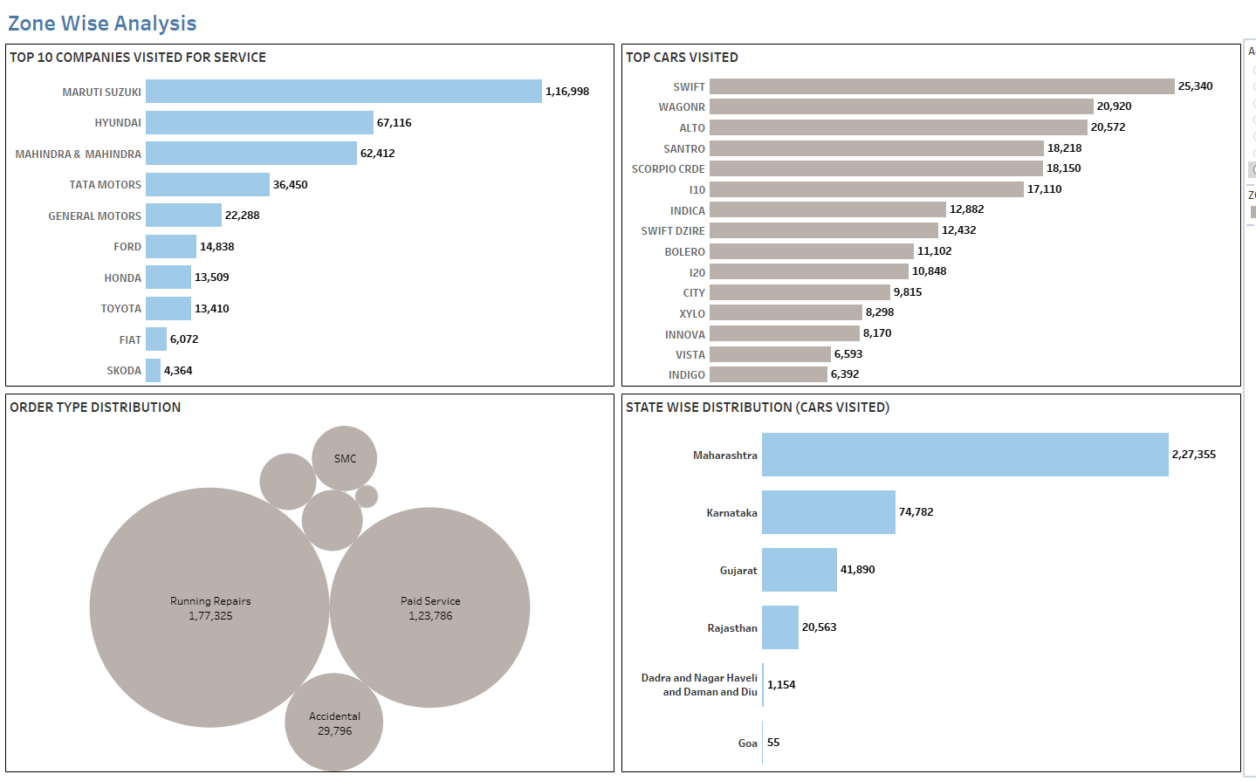
ZONE WISE ANALYSIS – WEST ZONE

Slide 10
DISCOVERY on ZONE WISE ANALYSIS
In all major zones the “running repairs” was the most frequent order type for servicing followed by “paid service” and “accidental” where as for North-East Zone “paid service” was the most frequent order type for servicing followed by running repairs and accidental.
In zones like North, South, West and North-East :- Maruti Suzuki, Mahindra& Mahindra and Hyundai company cars had the most frequent visits for servicing whereas in Central and Eastern Zone Tata company cars were most frequently visited along with Mahindra& Mahindra and Maruti Suzuki.
Swift, Alto and Wagon-R are the most frequent models which came for servicing in almost all zones.

Slide 11
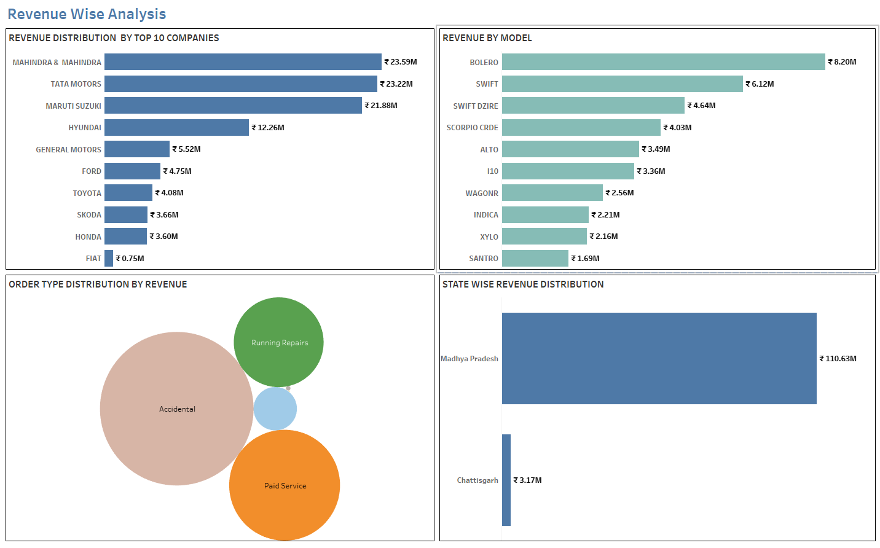
REVENUE WISE ANALYSIS – CENTRAL ZONE

Slide 12
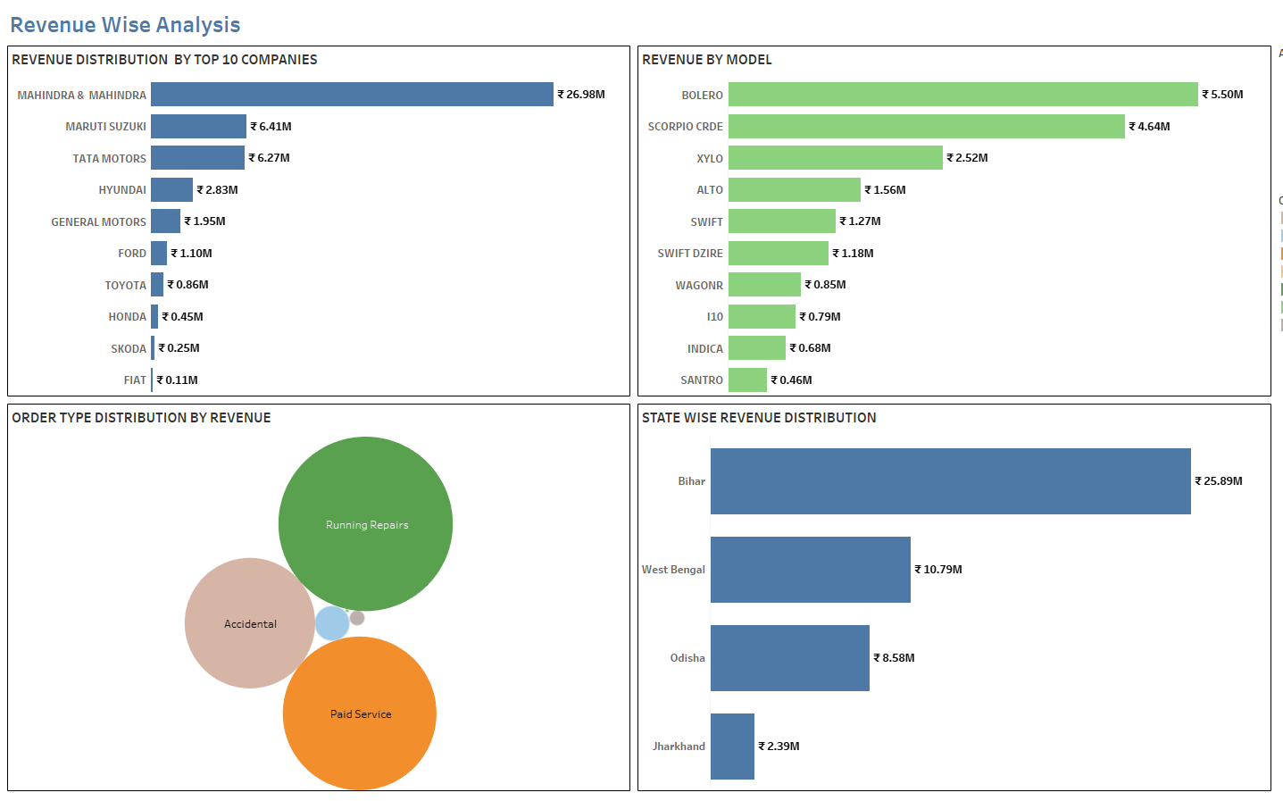
REVENUE WISE ANALYSIS – EAST ZONE

Slide 13
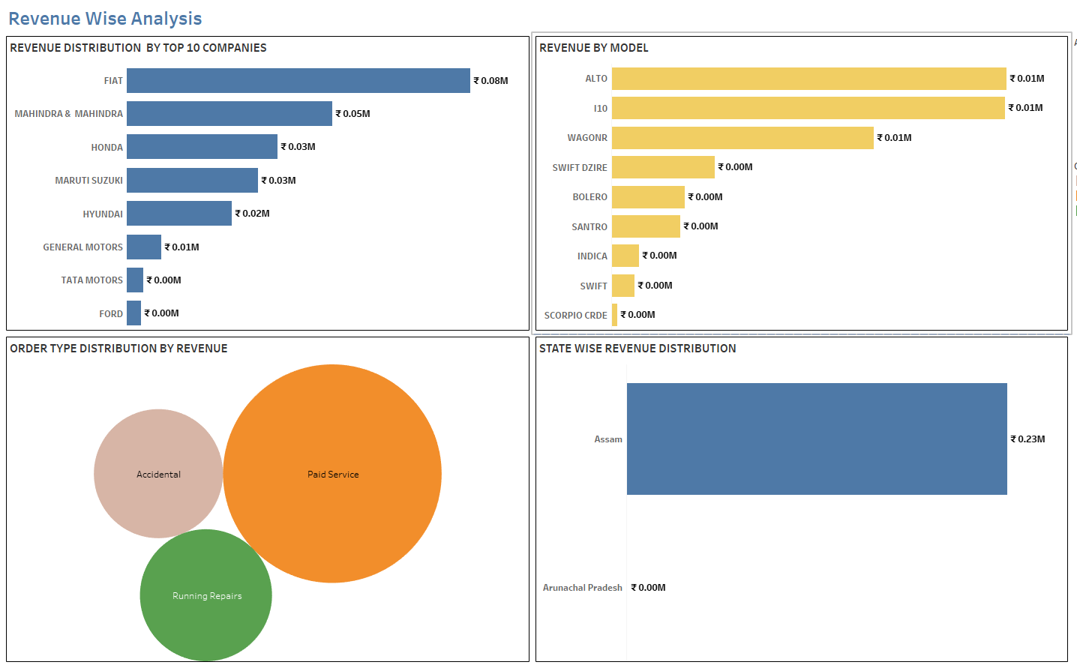
REVENUE WISE ANALYSIS – NORTH EAST ZONE

Slide 14
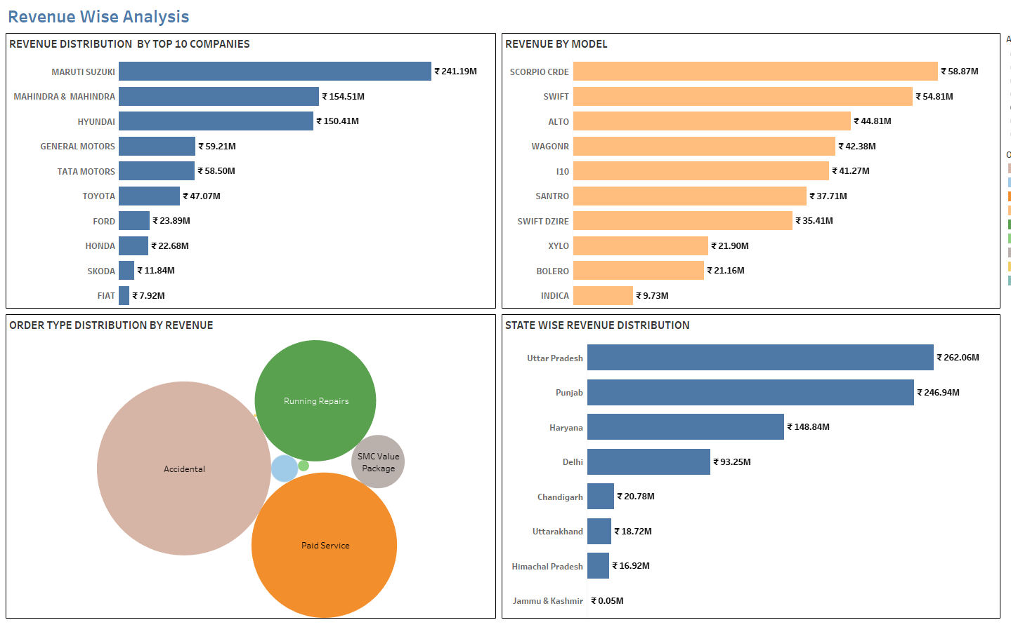
REVENUE WISE ANALYSIS – NORTH ZONE

Slide 15
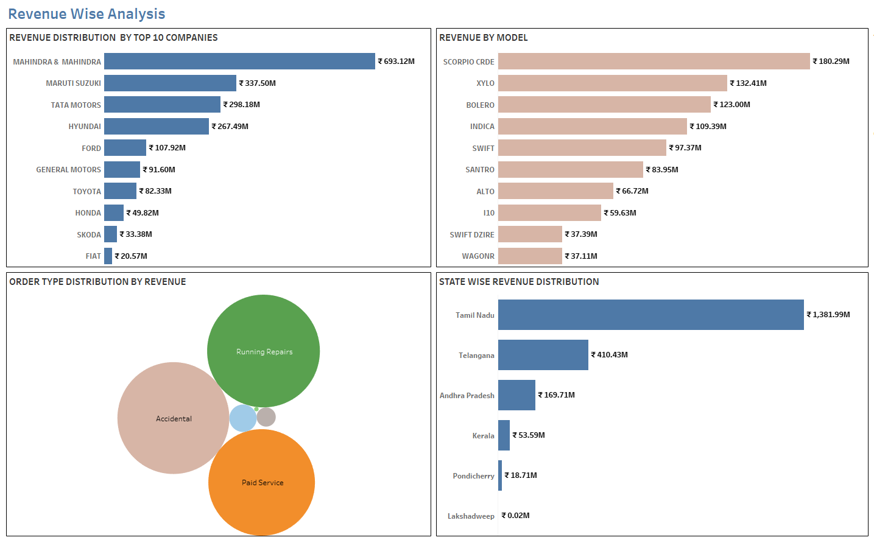
REVENUE WISE ANALYSIS – SOUTH ZONE

Slide 16
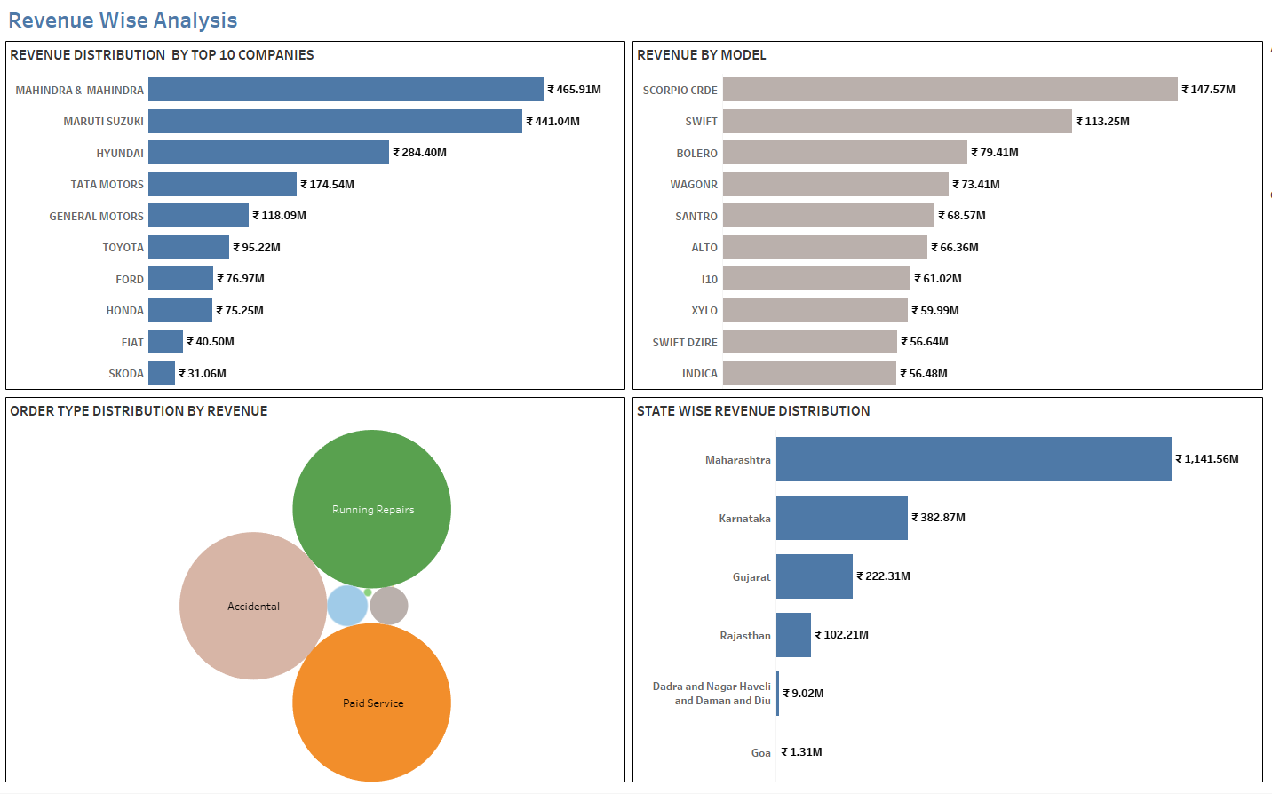
REVENUE WISE ANALYSIS – WEST ZONE

Slide 17
DISCOVERY on REVENUE WISE ANALYSIS
Mahindra & Mahindra, Maruti Suzuki and Hyundai are the companies with highest revenue in all zones.
Running Repairs ,Accidental and Paid Service order type are the major contributors to revenue in all zones
Scorpio CRDE, Swift and Bolero are the cars which gave the highest revenue for servicing in all zones.
Tamil Nadu,Maharashtra,Telangana,Karnataka are the states with highest revenue whereas Arunachal Pradesh,Assam,Goa are the states with least revenue contribution

Slide 18
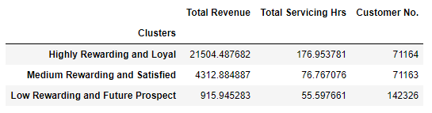
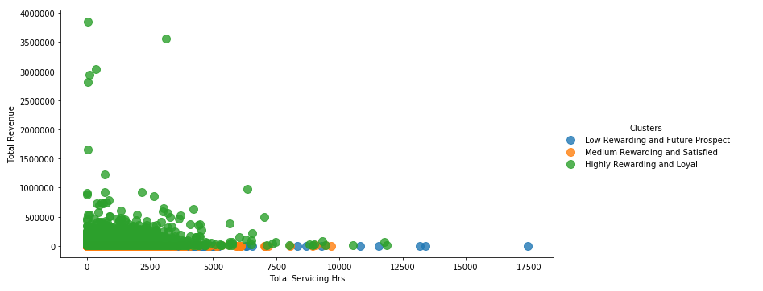
CLUSTER SEGMENTATION By REVENUE

Slide 19
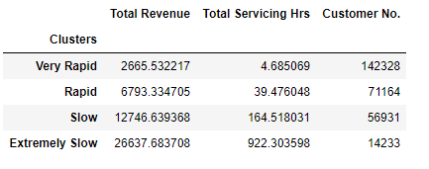
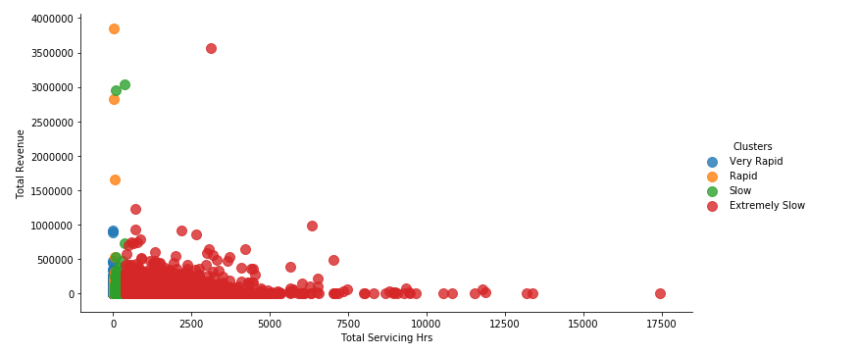
CLUSTER SEGMENTATION By SERVICE TIME

Slide 20
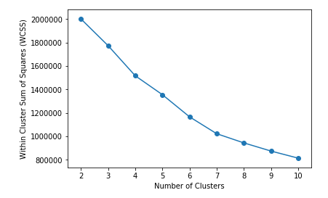
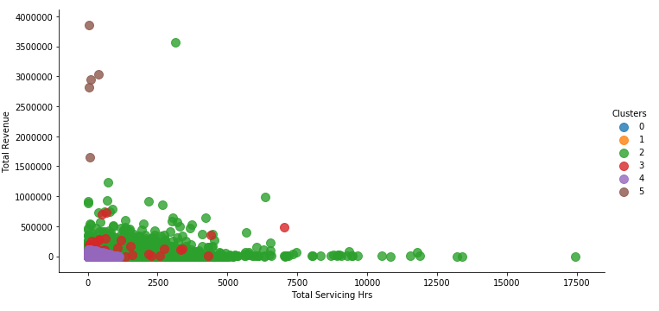
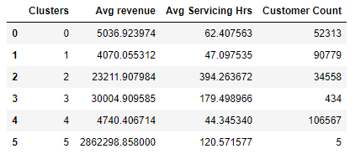
Final cluster – MARKET SEGMENTATION

Slide 21
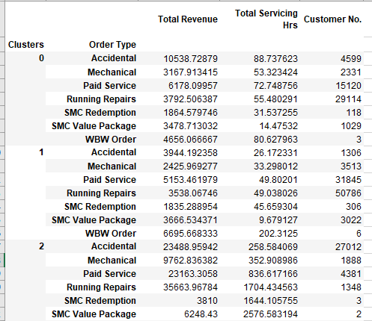
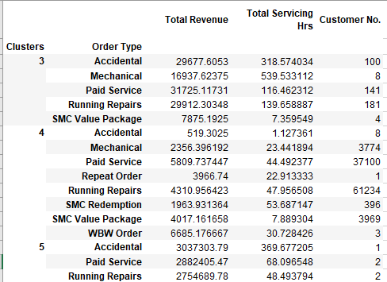
Final cluster – MARKET SEGMENTATION

Slide 22
Customer Life Time Value Prediction
Customer lifetime value is a metric that indicates the total revenue a business can reasonably expect from a single customer account.
It is calculated as Average purchase frequency multiplied by Average spend per visit.
For CLV calculation we have considered 2016 data
Classification Output - Low LTV Group (<2281)
Medium LTV Group( 2281 & 6664 )
High LTV Group (>6664)
Regression Output - Continuous LTV value

Slide 23
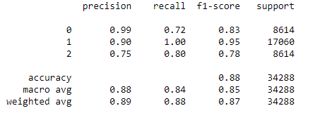
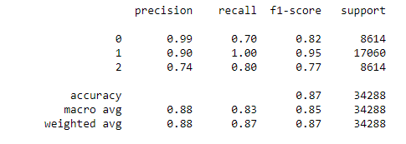
CUSTOMER LIFETIME VALUE PREDICTION
Decision Tree Classifier
Random Forest Classifier

Slide 24
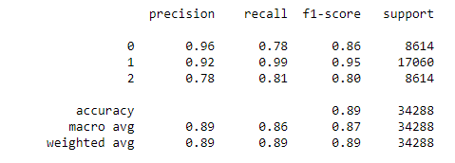
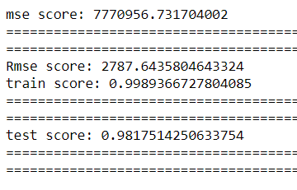

CUSTOMER LIFETIME VALUE PREDICTION
XgBoost Classifier
Decision Tree Regressor

Slide 25
Conclusion
The customer strength of Maharashtra and Tamil Nadu is very good. Similar kind of improvement in customer strength should attained in all other states.
Most of the customers coming to Mahindra first choice services are from retail background hence special attention must be given to them. Also Mahindra can launch membership plans like Platinum,Gold,Silver etc. for the customers with special discounts and complimentary offers. It will help to attract more customers and retain the existing ones with additional benefits.
Mahindra First Choice should target the following region like North Eastern States, Jammu Kashmir, Himachal Pradesh, Uttarakhand, Kerala, Goa, Rajasthan and Pondicherry. As these are highly visited road trip destinations and it can become a new potential market for Mahindra First Choice to establish new service centers for travel enthusiast and local people.
This will make sure that Customers will always have Mahindra First Choice as their preferred Service Center wherever they travel across the country and will benefit with the same quality of service as offered in big cities to remote holiday location.
Mahindra First Choice should also look after states in the Central and Eastern Region like Chhattisgarh, Jharkhand to increase their outreach.
Please take feedback survey from Customers after service is given across multiple outlets throughout the country. It can be used to find the quality of service. It will also help to improvise customer experience.

